Slide 1
Dashboards in MIS

Slide 2
What is an MIS Dashboard?
An easy-to-read real-time user interface showing a graphical presentation of the current status and historical trends of an organisation’s Key Performance Indicators to enable instantaneous and informed decisions to be made at a glance.

Slide 3
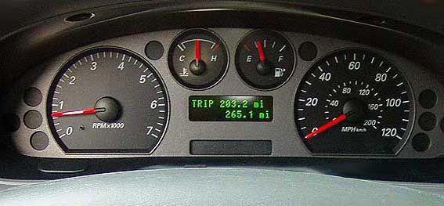
Why Dashboard?
It uses the metaphor of a car dashboard

Slide 4
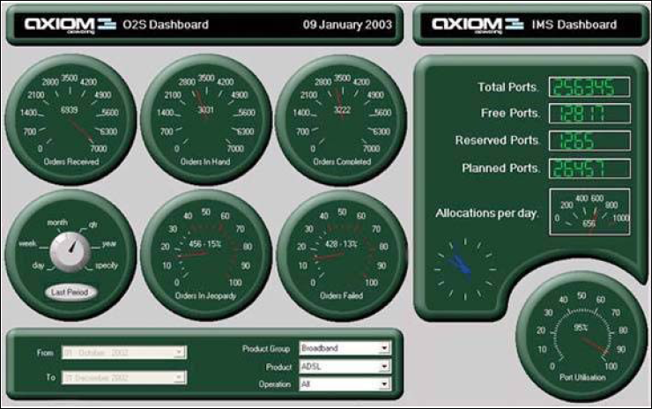
Bad example

Slide 5
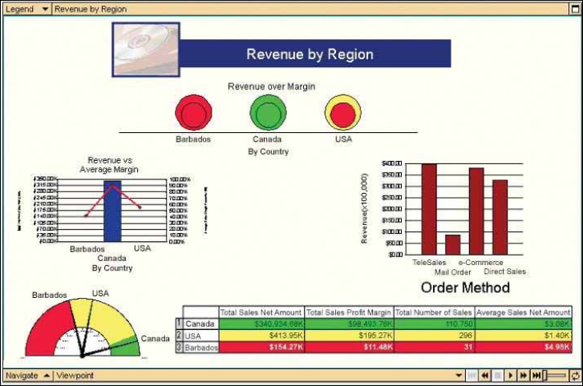
Ugly example

Slide 6
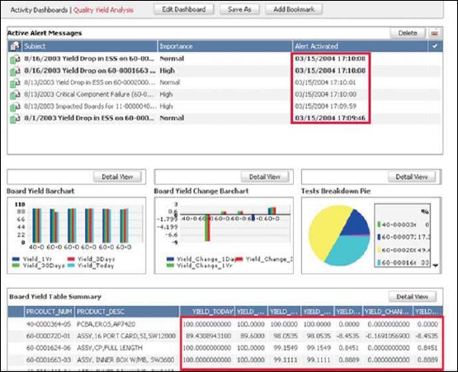
Too much detail

Slide 7
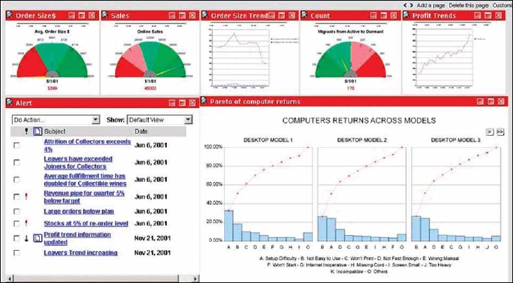
Business Objects Example

Slide 8
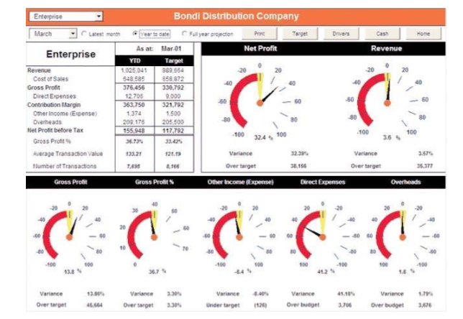
With dials

Slide 9
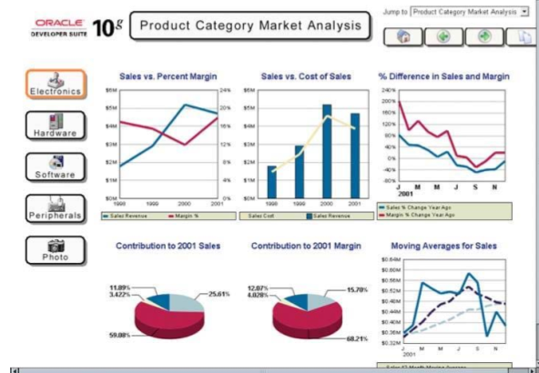
With graphs

Slide 10
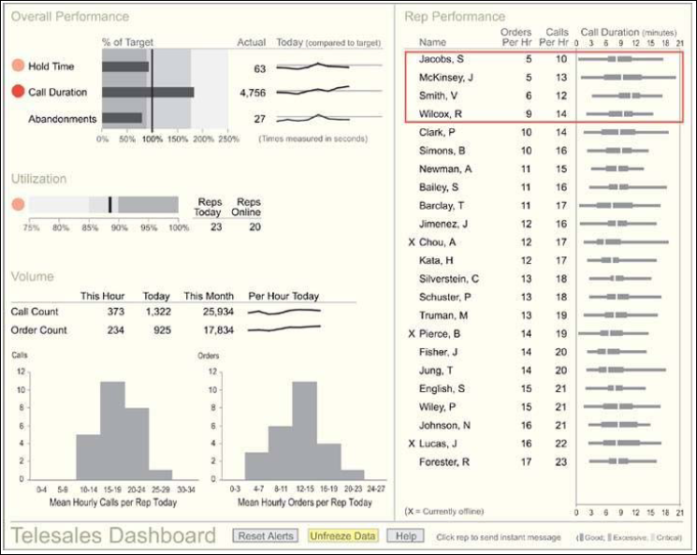

Slide 11

Why just one dashboard?

Slide 12
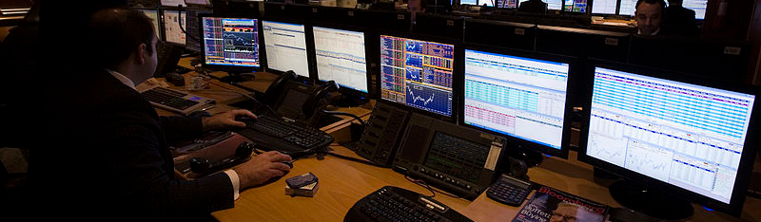
And more..

Slide 13

Responding to Dashboards!

